Slide 1
POSTOFFICE MANAGEMENT SYSTEM
Project by : AMAL.P
Register number:1826J08232
Guided by :
Mr. M .NANDAKUMAR M.sc,
Assistant Professor, Department of Computer Applications,
AJK College of Arts & Science,
Coimbatore-641105

Slide 2
INTRODUCTION
Post Office Management System project is a web based application for post office which helps post office management and their customers. It handles all types of transaction details of the post office and this project will reduce the clerical work as most of the work done by computer and customers can directly view all transaction details without visiting post office. As the name suggests, the Post Office Management System is an application that will allow reducing the manual work that is done at the post office. This application will provide an automated system in managing the post office related works. This application will manage all the transactions that take place at the post office. This will be one of the interesting applications that one can work on and implement in real time world. Most of the clerical work is reduced since it is done through this automated application. The transaction details can be directly viewed by the customers through this application with great ease.

Slide 3
SYNOPSIS
•
The project entitled as "POSTOFFICE MANAGEMENT SYSTEM" is a web based application project for post office which helps post office management and their customers. This handles all types of transaction details of the post office and this project will reduce the clerical work as most of the work done by computer and customers can directly view all transaction details without visiting the post office.
The frontend of the project is VB.NET and the backend is MS SQL SERVER database. WINDOWS 10 is used as the operating system.
The EXISTING SYSTEM of postal services and management is not advanced as it does not contain courier transactions. This system is uneconomical, unreliable and insecure. The PROPOSED SYSTEM of post office management is a software application makes the management and operational procedures easy in a post office. With this system details such as post, money order etc. can be easily managed and controlled via the main menu of the software.
The project consist of three main modules. In ADMIN module, admin can login and register using username and password. In USER REGISTRATION module user can login and register, view and update own data. In POSTAL SERVICE module user can see details about various services available in post office.
•
•
•

Slide 4
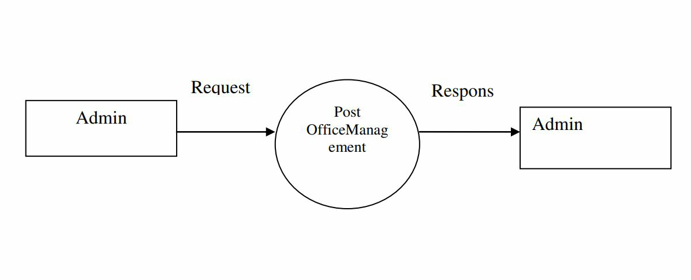
DATA FLOW DIAGRAM
Level 0

Slide 5
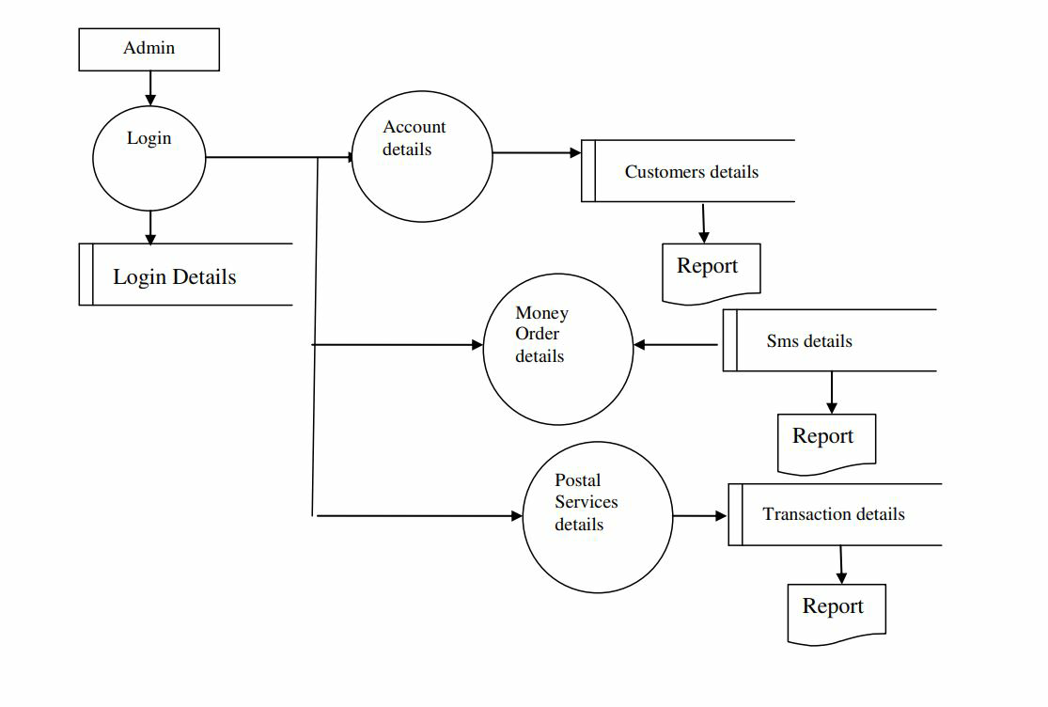
Level 1

Slide 6
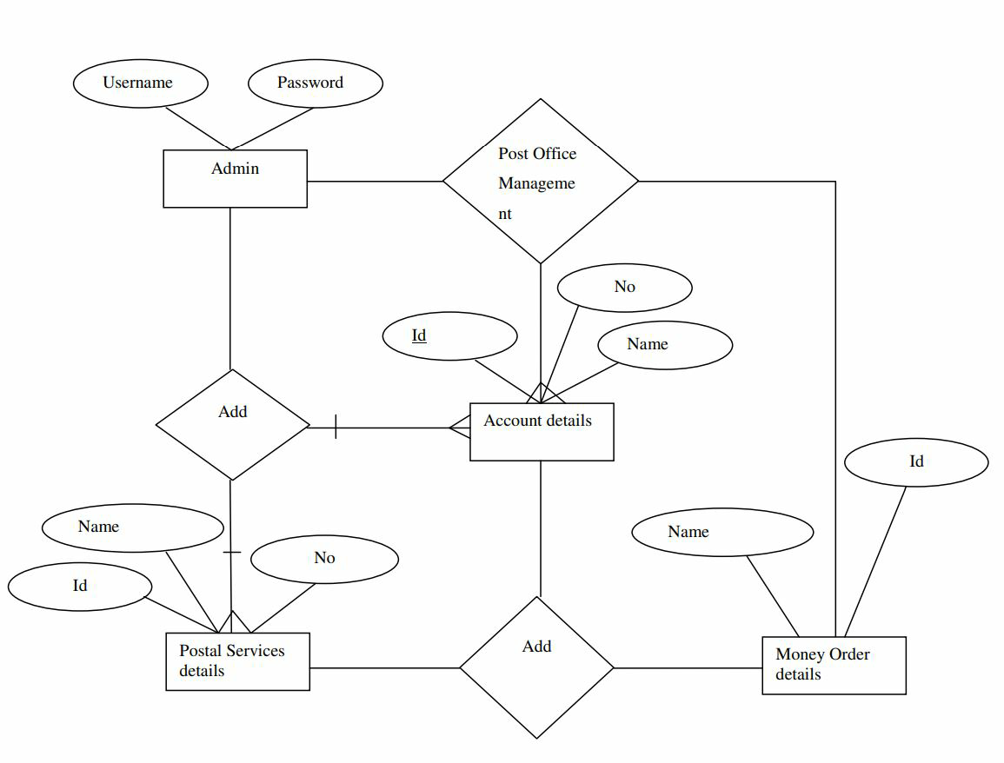
ER DIAGRAM

Slide 7
TABLE DESIGN
Table Name : Admin Login
Field Name | Data Type | Description
UserName | Varchar(35) | Describe admin name
Password | Varchar(35) | Represent password

Slide 8
Table Name: Money Order
Field Name | Data Type | Description
M_Id | int | money order number
M_Address | Varchar(150) | sender address
M_ToAddress | Varchar(150) | Receiver address
M_Mobile | bigint | It represents mobile no
M_Name | Varchar(35) | receiver name
M_Pin | bigint | receiver pincode
M_Amount | bigint | it represents amount
Date | Varchar(10) | Date of sending money order

Slide 9
Table Name: Post Details
Field Name | Data Type | Description
P_Id | Varchar(10) | Postal number
P_Type | Varchar(20) | Type of post
P_Address | Varchar(100) | Postal address
P_ToAddress | Varchar(100) | Receiver post address
P_Mobile | Varchar(10) | Mobile number
P_Name | Varchar (20) | Post name
P_Pin | Int(10) | Pincode of post
Date | Varchar(10) | Date of sending post

Slide 10
Table Name: User Registration
Field Name | Data Type | Size | Description
Name | Varchar | 20 | Describe user name
Gender | Varchar | 100 | Represent gender type
Dob | Varchar | 100 | User date of birth details
Address | Varchar | 200 | It represents user address
Mob_No | Varchar | 30 | It represents phone number
Account_Id | Varchar | 30 | It represents account id
Account_No | Int | 50 | It represents account number
BankName | Varchar | 50 | Its represents bank name
BranchName | Varchar | 30 | It represents branch name
Month | Varchar | 10 | It represents month
Year | bigint | 10 | It represents year
Date | Varchar | 50 | It represents date

Slide 11
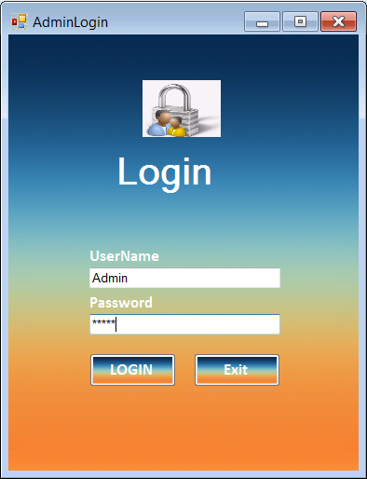
FORM DESIGN

Slide 12
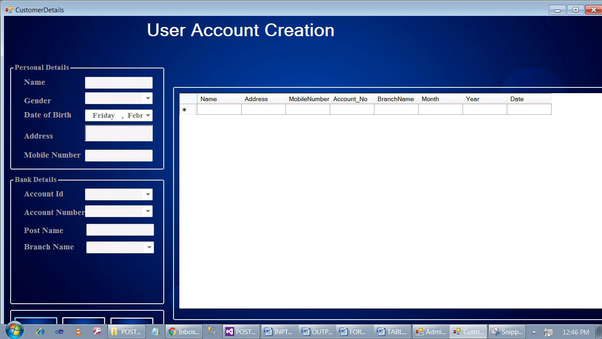

Slide 13
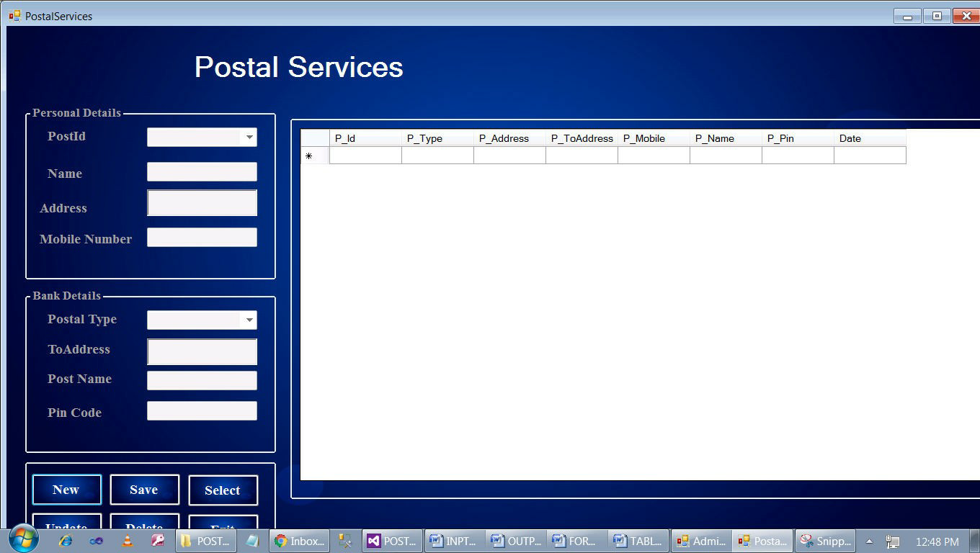

Slide 14
CONCLUSION
It has been a great pleasure for me to work on this exciting and challenging project. This project proved good for me as it provided practical knowledge of not only programming in VB.NET web based application and no some extent Windows Application and SQL Server, but also about all handling procedure related with “Post Office Management System”. It also provides knowledge about the latest technology used in developing web enabled application and client server technology that will be great demand in future. This will provide better opportunities and guidance in future in developing projects independently.

